Slide 1

Select your driver
Africa-first, next generation mobility platform
TIMO
CONFIDENTIAL

Slide 2

“Redefining how the world moves across Africa’s tourism cities”
Timo is the first African mobility company built for the era of decentralisation.
We combine deep sector knowledge with web3 principles and emergent technology, to empower riders to travel with confidence, and drivers to work with dignity.
Identity, Safety, Interoperability and Choice lie at the heart of our build. We have a strong network of luxury vehicles, tourism partners and corporates waiting for our solution.

Slide 3

“Redefining how the world moves across Africa’s tourism cities”
• Focus areas: differentiation, scalability, unit economics.
• Pilot validated: 10K riders | 500 drivers | 5K rides | ZAR 350K revenue.
• Target: $1–2M ARR by 2027.

Slide 4
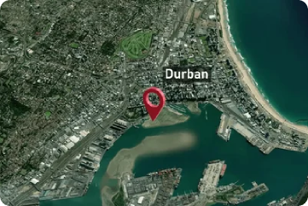

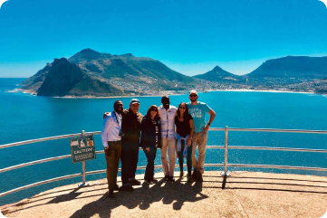
Rule of one Beachhead strategy
Goal: Capture 1% of Durban tourism spend ($500K GMV).
Focus Market: Durban, South Africa – $50M+ tourism mobility gap.
Core Problem: Limited premium transport for tourists.
Beachhead Path:
Durban → Victoria Falls → Livingstone.

Slide 5






The Potential of Decentralised Mobility
Reliance on centralised technology providers is holding us back. Uber and Bolt hold all user data, and make all the rules. This lack of transparency is frustrating for drivers, and locks users in. Timo imagines a different reality:
KEY DIFFERENTIATORS
Technical
Differentiation
Works offline
Mobile money /
stablecoins
Timo doesn’t need a constant internet connection to function - and can even operate via bluetooth connection.
Rides are cashless,
enhancing safety and convenience
and allowing people without bank accounts to benefit from the platform
Timo combines several emergent technologies, giving us a tech stack that focuses on interoperability, identity, and robustness.
Also notable is our focus on deep integrations with local businesses and government.
Highly scalable
Identity + Trust Layer
Timo utilises auto-failover and auto-load balancing - ensuring the app has zero downtime and smooth, reliable service
All riders and drivers are credentialled using an interoperable identity layer - improving trust and safety incrementally.
Web2 + web3 interoperable
Local partnerships
+ Government Integration
Timo uses Abstraction Layer technology, giving seamless access to both blockchain and database systems.
We bring PathPulse to Africa,
creating a road intelligence layer that transforms every vehicle into a live data node with just a smartphone and dashcam.

Slide 6


Interoperable standard
Timo embeds seamlessly into partner platforms and provides revenue sharing options for fast adoption
On-chain payments
Next-generation integrations
Timo capitalises on emergent systems in AI and Zero Knowledge proofs, to generate additional revenue and added layers of protection for users.
Data-as-a-service
Zero Knowledge KYC
Timo rides generate real time traffic data, informing AI models and generating new revenue streams
ID Verification is managed securely, preventing fake accounts while preserving user privacy.

Slide 7
Current Issues with Ride Hailing in Africa
In 2025, the Ride Hailing industry is at a breaking point - with citywide driver strikes affecting Uber and Bolt, and confidence in trust and safety at an all time low. Here are the core issues for both drivers and riders.
Riders
Drivers
Safety concerns
Lack of personalization
High commission cuts
Unstable demand:
Limited transparency on driver background, vehicle condition, and trip monitoring undermines trust.
Zero option to choose preferred drivers or vehicles leads to impersonal experiences.
Losing up to 45–50% of earnings to platforms, while fuel and operating costs rise.
Ride requests are inconsistent, especially outside major cities.
Unreliable service
Connectivity gaps
Limited Ownership
Connectivity gaps
Frequent cancellations, late arrivals, and inconsistent quality disrupt travel plans.
Existing ride-hailing apps fail in low or no internet signal areas, leaving passengers stranded.
Drivers have no stake in the platform’s growth and can’t build lasting customer relationships.
Inability to reliably receive bookings or complete trips in low-signal zones reduces earnings

Slide 8
Timo’s Solution:
We have a build that tackles each of these issues for both rides and drives- combining business insight and technical innovation.
Riders
Drivers
Enhanced safety
Choice & comfort
Fair earnings
Steady demand
Verified drivers, transparent profiles, and real-time trip monitoring ensure trust.
Ability to select preferred drivers and vehicles tailored to trip needs.
Lower platform rates improve take-home pay amid rising costs.
Direct partnerships with hotels, airports, and event organizers secure consistent ride requests.
Reliable scheduling
Offline-capable
Ownership model
Offline job management
Drivers and community-owned fleets share in platform growth, building loyal customer bases and benefiting long-term.
Advance booking with guaranteed on-time arrivals to reduce disruptions.
Works seamlessly in low or no internet areas, automatically reconnecting when signal returns.
Ability to accept and complete rides without continuous internet connectivity ensures work continuity in low-signal zones.

Slide 9
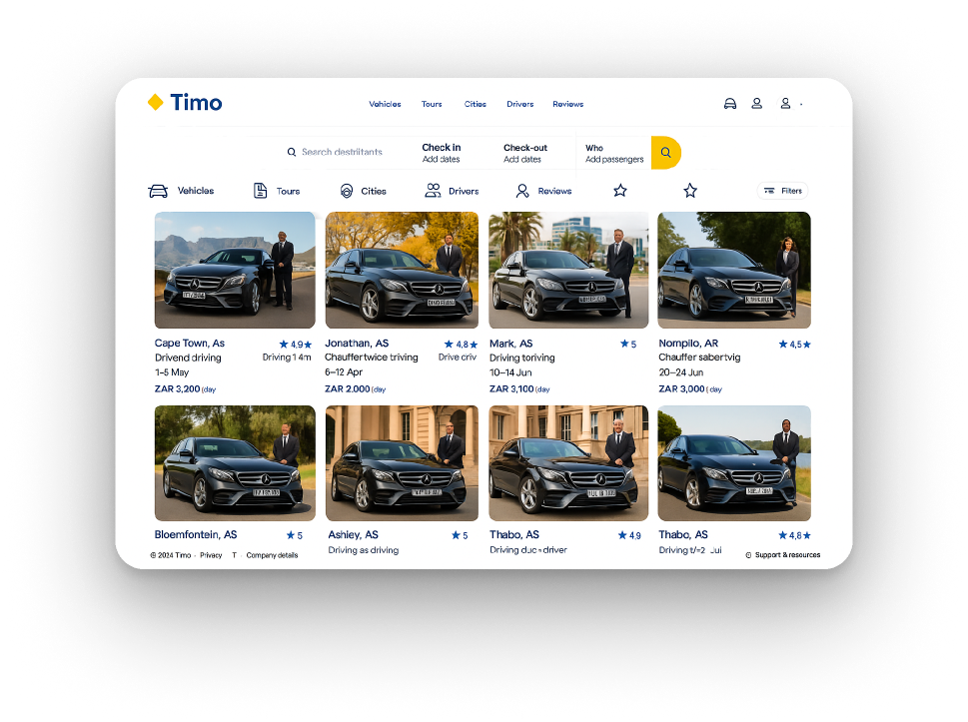
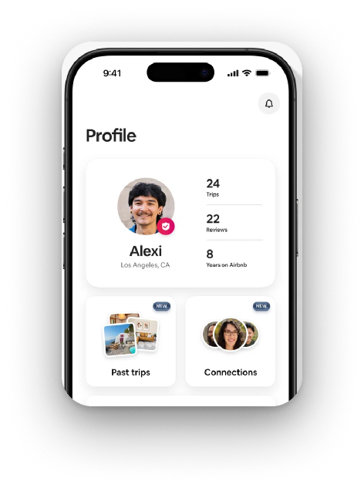
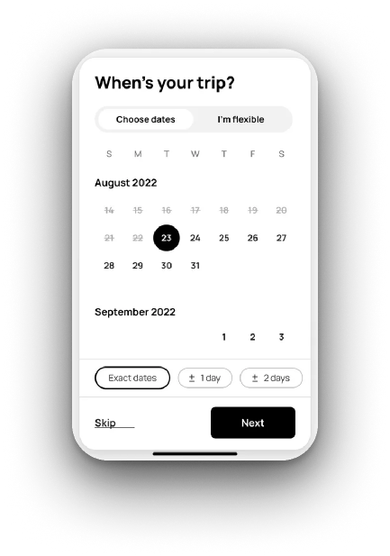
An Africa-first decentralised mobility brand
Timo is the first African mobility company built for the era of decentralisation.
We combine deep sector knowledge with web3 principles and emergent technology, to empower riders to travel with confidence, and drivers to work with dignity.
Identity, Safety, Interoperability and Choice lie at the heart of our build. We have a strong network of luxury vehicles, tourism partners and corporates waiting for our solution.
Timo embeds seamlessly into partner platforms and provides revenue sharing options for fast adoption
Product: Full choice + customisability
We give users the ability to choose everything about their ride, down to the smallest detail.
This unlocks trust for tourism operators and corporates who wish to know who they are riding with ahead of time.
In addition, Timo embeds into partner portals for a seamless experience, with revenue sharing options.
Timo
Book in advance, just like you do on Air Bnb
Find the ride that suits your exact preference
Check their reviews, ratings, and personal traits
Schedule your ride
Choose your vehicle
View your driver

Slide 10
KEY DIFFERENTIATORS
TIMO
OTHERS
WHY IT MATTERS
Choice
Scheduled rides with personalized features (vehicle type, driver, comfort).
Focus on on-demand with little customisation
Tourists and professionals want reliability
Tourism focus
Partners with hotels, airports, airlines, and tourism boards.
Focus on B2C only.
We access institutional demand with lower CAC.
Interoperability
Connects to hotel systems, event apps
Closed systems, limited API access.
Enables rapid scaling via partnerships
Commission-Based Ecosystem
100% cashless; partners earn via affiliate QR codes.
Transactional; no partner incentives.
Aligns incentives — makes Timo worth promoting.
Local Ownership & Trust Layer
Community-based fleets, trained drivers, ratings, ID, feedback.
Centralized driver onboarding.
Builds safety, cultural sensitivity, and reliability.
Focus on Underserved Markets
Africa-first; built for low-signal, fragmented regions.
Struggles in these areas.
Timo unlocks latent demand — gains first-mover advantage.
Enterprise & Events Ready
Ride bundles, corporate billing, branded guest services.
Minimal or no enterprise features.
High-LTV B2B market with repeat demand.

Slide 11



The Potential of Decentralised Mobility
Reliance on centralised technology providers is holding us back. Uber and Bolt hold all user data, and make all the rules. This lack of transparency is frustrating for drivers, and locks users in. Timo imagines a different reality:
KEY DIFFERENTIATORS
Fare Structure & Dynamic Pricing
Tourism premium adds 15–20% margin.
Adaptive engine supports ZAR/USD/ZMW.
Avg. Fare: $6.80 |
Driver Take-home: $5.44 (20% commission)
Gross margin: 25–30%
(vs. 15–20% industry avg).

Slide 12
Executive Summary
Executive Summary
Executive Summary
Executive Summary
MISSION
Tourism market Penetration
MOUs signed
Airport & Hotel
Tourism Board
Target: 50K riders in Y1 | 20% repeat rate

Slide 13
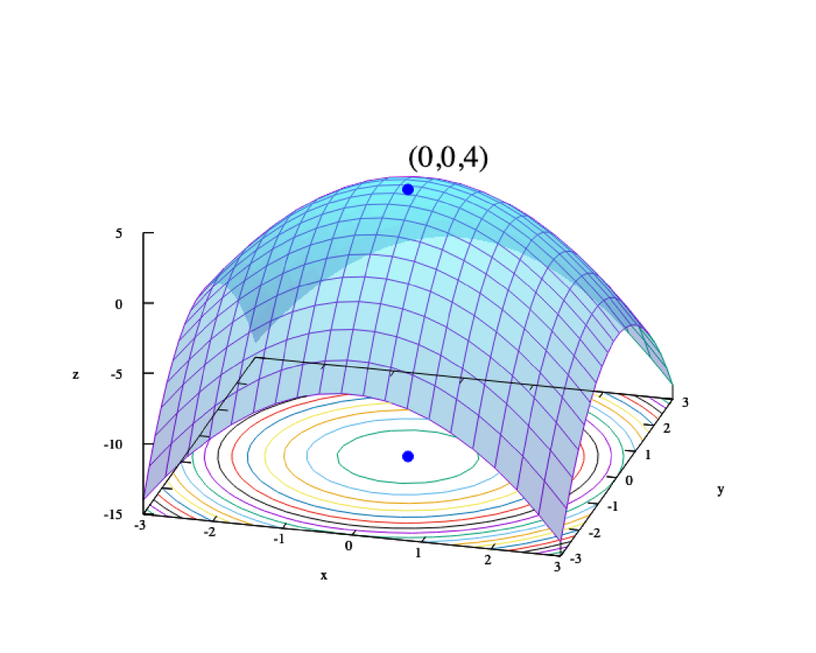
Interoperable standard
Timo embeds seamlessly into partner platforms and provides revenue sharing options for fast adoption
On-chain payments
Unit Economics Optimization
Pilot → Next 6 Months Targets:
Driver Utilization: 10 → 80 rides/month (8x)
• Revenue per Ride: $3.6 → $7–$10 (2.5x)
• Gross Margin: 8% → 25%+
Levers: PathPulse routing | Pre-booked tourism rides | Driver incentives

Slide 14






Interoperable standard
Timo embeds seamlessly into partner platforms and provides revenue sharing options for fast adoption
On-chain payments
Cross Border Scalability & Risk Mitigation
Local partnerships → 60% licensing risk reduction
Multi-currency wallet (ZAR/USD/ZMW)
Compliance templates → <45 days new market launch.

Slide 15
Technical
Differentiation
Mobile money /
stablecoins
Timo doesn’t need a constant internet connection to function - and can even operate via bluetooth connection.
Rides are cashless,
enhancing safety and convenience
and allowing people without bank accounts to benefit from the platform
Highly scalable
Identity + Trust Layer
Timo utilises auto-failover and auto-load balancing - ensuring the app has zero downtime and smooth, reliable service
All riders and drivers are credentialled using an interoperable identity layer - improving trust and safety incrementally.
KEY DIFFERENTIATORS
Market Opportunity
$40B
$5B
$200m
Tourism spend Southern Africa
Mobility SAM
Timo SOM
2025: 10K riders | 2026: 50K | 2027: 120K
Revenue: $35K → $1.8M (break-even).
TIMO
CONFIDENTIAL

Slide 16




CORE TEAM
Eddison Shumba
CEO https://www.linkedin.com/in/eddison-shumba-356a2166/
Max Gershfield
CSO
https://www.linkedin.com/in/max-gershfield
4 years’ experience working for Uber’s Global Creative Team, 4 years experience working inside web3 with OASIS Web4, and award-winning web3 marketing agency Flight3. Max is a highly experienced strategist with a broad understanding of emergent technologies and startups.
Cordy Joseph
CMO
https://www.linkedin.com/in/cordy-joseph-2ab8a1a9/
Strategist at the intersection of crypto, mobility, and frontier markets. With 8+ years of experience in decentralized identity, payments, and ecosystem design, Cordy is the founder of HNDL (Bitcoin-based identity) and CEO of FameGuild (AI agents + creator economies). At Timo, he leads growth and platform strategy—integrating trust layers, mobile money, and web3 infrastructure to position Timo as Africa’s category-defining mobility network.
David Ellams
CTO
https://www.linkedin.com/in/david-ellams-77132142/
David is the architect of OASIS Web4, an interoperability layer spanning web2 and web3. David has over 18 years in professional IT, contracting for companies including Nokia, HSBC, and KPMG.
Entrepreneur, VC fellow, and startup ecosystem builder with 10+ years’ experience. At TIMO, he leads innovation in tourism and mobility across Africa. He’s also co-leading ProtoSeed Ventures, backing student-led tech startups. Eddison has mentored 1,000+ founders, contributed to early-stage capital programs, and received recognition from UNDP, ILO-GIZ, and the Ford Mobility Fellowship.
TIMO
CONFIDENTIAL

Slide 17


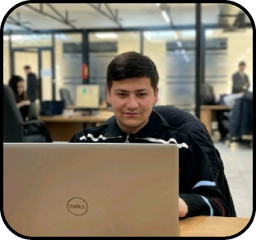
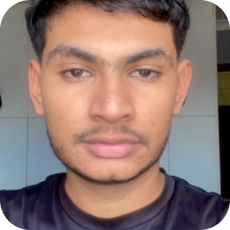
Traction Signals
5K+
500+
4
Rides completed During pilot phase
Registered Drivers Across Africa
Key Partnerships Tunisia King Events, AMC Chauffeur, SATC, Durban networks
TECH TEAM
Faridun Berdiev
Tech Lead https://www.linkedin.com/in/christineheiss/
Qurbonali Nazarov
Back-end developer
https://www.linkedin.com/in/qurbonali-nazarov-8837b2310/
Backend Developer with expertise in .NET Core, Entity Framework Core, and ASP.NET Core. Proficient in building robust backend solutions to support scalable applications.
Aziz Bobokhujaev
Front-end
https://www.linkedin.com/in/aziz-bobokhujaev-245bb2229/
Aziz focuses on UX / UI, He is familiar with HTML, CSS, and Tailwind CSS. Dedicated to delivering efficient and reliable software solutions.
Sahil Jada
Full stack
https://www.linkedin.com/in/david-ellams-77132142/
South African-based full-stack developer focused on building real-world web applications using the MERN stack
Faha is a highly experienced .NET developer, and the founder of the .NET Academy - a school which produces high quality professional Software Engineers. He has over 5 years as a professional software developer, focusing on back-end and distributed systems, as well as web3 technologies, smart contracting and token bridging.
TIMO
CONFIDENTIAL

Slide 18


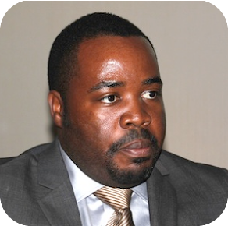
Executive Summary
BOARD OF ADVISORS
Eric Osiekwan
Board Member
Eric is a renowned entrepreneur and investor with over 25 years of experience in the ICT sector across Africa and beyond. He has worked in 32 African countries, leading the establishment of Internet Service Providers (ISPs), Internet Exchange Points (IXPs), and high-growth tech startups. Eric is the Co-Founder of Angel Africa List and Angel Fair Africa, and currently serves on the board of Farmerline, among others. As an active investor and ecosystem builder, his influence spans across infrastructure, innovation, and capital—making him an invaluable asset to Timo’s strategic direction and growth in African markets.
Anna Ressa
Board Member
Anna is an experienced EU Project Manager at TECNOPOLIS Science & Technology Park in Puglia, Italy. With over two decades of expertise, she specializes in designing and managing funded projects across sectors such as culture, business development, agriculture, territorial promotion, youth empowerment, technological innovation, and international cooperation.
Anna combines strategic thinking with hands-on project execution, working with programs like Interreg, Horizon Europe, and UIA. She is also an independent consultant in European project planning and a former lecturer in EU project design. Anna actively contributes to sustainable growth through collaborative initiatives at the local, national, and EU levels.
Tinyiko Valoyi
Board Member
Tinyiko is a seasoned technology executive and telecoms entrepreneur. He was most recently the CEO of iBurst Africa, a pioneering wireless broadband group, where he led the company’s first expansion into West Africa by establishing operations in Ghana. Under his leadership, iBurst raised over $33 million to scale its footprint across Ghana, Mozambique, Kenya, and the DRC. Prior to this, he served as Chief Technology Officer at RMB Private Bank, where he spearheaded critical modernization efforts—integrating legacy mainframe banking systems like Hogan and Phoenix into modern service-oriented architectures. Tinyiko brings a rare blend of strategic vision, fundraising experience, and deep technical expertise to the board.
TIMO
CONFIDENTIAL

Slide 19
Executive Summary
Executive Summary
Executive Summary
Executive Summary
MISSION
The Potential of Decentralised Mobility
Mobility Marketplace
Interoperable standard
We believe that users want the ability to choose their ride down to the smallest detail. Our marketplace gives them the tools to do so, displaying clear driver profiles and vehicle conditions for a worry-free experience
Timo embeds seamlessly into partner platforms and provides revenue sharing options for fast adoption
Reliance on centralised technology providers is holding us back. Uber and Bolt hold all user data, and make all the rules. This lack of transparency is frustrating for drivers, and locks users in. Timo imagines a different reality:
Identity System
On-chain payments
Trust is of the utmost importance to fostering a safe platform - and it builds over time. Our cross-chain identity system builds trust with every completed ride, and is owned by the user - meaning it can be taken off Timo at any point.
Timo embeds both mobile money and stablecoins payments, offering immediate settlement as well as advanced credit options that assist drivers.

Slide 20


MISSION
Designed for trust, not just for transport

Slide 21








KEY DIFFERENTIATORS
Traction Signals
5K+
500+
4
Rides completed During pilot phase
Registered Drivers Across Africa
Key Partnerships Tunisia King Events, AMC Chauffeur, SATC, Durban networks
And recognition from:
TIMO
CONFIDENTIAL

Slide 22
FUNDRAISING
Term sheet:
Instrument: SAFE
Discount: 20%
Raise amount:
$500,000
Valuation
$2,500,000
WHICH WILL BE USED ON
30%
25%
20%
10%
15%
Product development PathPulse integration
Tourism Partnership
Marketing & Incentives
Legal & Compliance
Reserve & Contingency
TIMO
CONFIDENTIAL

Slide 23
REVENUE MODEL
PROFIT MECHANISM
Customer Segments | Daily commuters, Tourists, Corporate clients
Competitive Pricing Strategy | Competes with Uber Black and Uber Premium
Ride Fares | Base fare: R30 Price per km: R17 Price per minute: R1.60 Minimum fare: R60
Average ride assumptions | Average distance: 10km Average time: 15 minutes
Total fare calculation | Distance charge: R170 (R17/km x 10km) Time charge: R24 (R.16/min x 15 min) Total fare: R224 (Base + Distance + Time)
Projected revenue growth | Average Total Fare per ride: R224 Total Rides Needed (Breakeven): 6,757 rides Estimated Monthly Revenue at Breakeven: R1,511,568
Risks and mitigation | Key risks: Regulatory changes, competition Mitigation strategies: Adapt pricing and services
Cost structure | Driver commission: 20% (Timo rides retainer) Driver payout: R179.20 (80% of R224) Operational Costs: R30 Total Cost per ride: R209.20
Profitability Metrics | Contribution margin per ride: R14.80 Monthly fixed costs: R100,000 Net profit per month at breakeven: R100,000 Profit Margin Percentage: ~15.6%
Breakeven analysis | Breakeven point: 6,757 rides/month Estimated rides needed per day: 225.2 Number of drivers needed: 23
Path to profitability | Growth Strategy: Increase user base and ride frequency Cost management: Optimise payouts and operational costs

Slide 24
SUMMARY
Timo presents a venture-scale opportunity in Africa's rapidly evolving mobility sector. We have the partners, infrastructure, and ambition to build a category-defining platform. This pre-seed raise will position us to launch, scale rapidly, and deliver on a vision that global platforms have yet to realize across the continent.
TIMO
CONFIDENTIAL

